Slide 1


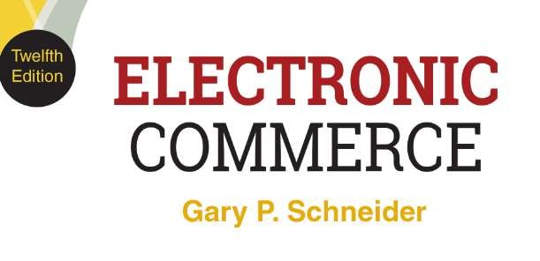
CHAPTER 13
The Environment of Electronic Commerce: Legal, Ethical, and Tax Issues

Slide 2
The Legal Environment of Electronic Commerce
All businesses must comply with the same laws and regulations and face the same set of penalties
Web businesses face additional complicating factors
Web extends reach beyond traditional boundaries
Subject to more laws more quickly than brick-and- mortar business
More interactive and complex customer relationships
Online communications facilitate strategic alliances and supply web relationships
Law violations or ethical breaches can lead to rapid and intense reactions almost instantly
© 2017 Cengage Learning®. May not be scanned, copied or duplicated, or posted to a publicly accessible website, in whole or in part, except for use as permitted in a license distributed with a certain product or service or otherwise on a password-protected website or school-approved learning management system for classroom use.
2

Slide 3
Borders and Jurisdiction
In the physical world of traditional commerce, territorial borders clearly mark the range of culture and reach of applicable laws
Geographic influences of culture limit acceptable ethical behavior and affect laws both directly and indirectly
Relationship between geographic and legal boundaries defined by four variables
Power, effects, legitimacy, notice
© 2017 Cengage Learning®. May not be scanned, copied or duplicated, or posted to a publicly accessible website, in whole or in part, except for use as permitted in a license distributed with a certain product or service or otherwise on a password-protected website or school-approved learning management system for classroom use.
3

Slide 4
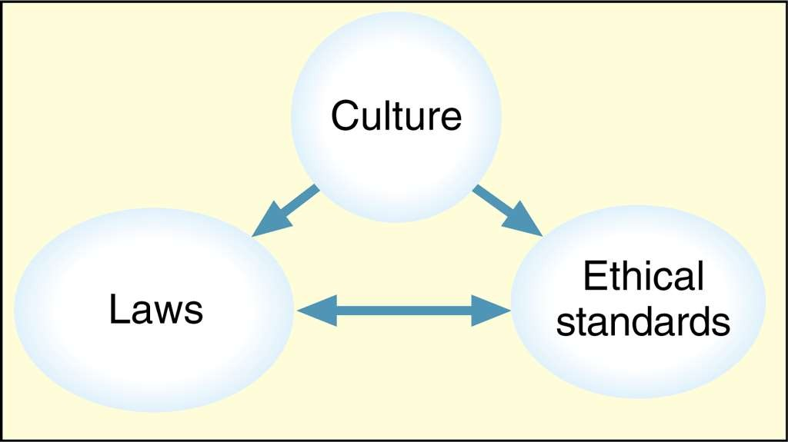
© Cengage Learning 2017
FIGURE 7-1 Culture helps determine laws and ethical standards
© 2017 Cengage Learning®. May not be scanned, copied or duplicated, or posted to a publicly accessible website, in whole or in part, except for use as permitted in a license distributed with a certain product or service or otherwise on a password-protected website or school-approved learning management system for classroom use.
4

Slide 5
Power and Effects
Power is the form of control over physical space and people and objects that reside in that space
Defining characteristic of statehood
Jurisdiction is government’s ability to exercise power
Limited to that which is accepted by the geographical
culture
Effects are the impact of a person’s behavior
Generally stronger on things that are physically closer
Laws based on traditional effects-based measures do
not work as well for online businesses
© 2017 Cengage Learning®. May not be scanned, copied or duplicated, or posted to a publicly accessible website, in whole or in part, except for use as permitted in a license distributed with a certain product or service or otherwise on a password-protected website or school-approved learning management system for classroom use.
5

Slide 6
Legitimacy and Notice
Legitimacy is the idea that those subject to laws should have some role in formulating them
Online businesses face a variety of regulations
Notice is the expression of a change in rules
Easy for physical boundaries but not easy online
Constructive notice of new laws and norms is received when an international border is crossed
Ignorance of law: not sustainable defense
Creates problems for online businesses when unknown customers from other countries access Web sites
© 2017 Cengage Learning®. May not be scanned, copied or duplicated, or posted to a publicly accessible website, in whole or in part, except for use as permitted in a license distributed with a certain product or service or otherwise on a password-protected website or school-approved learning management system for classroom use.
6

Slide 7
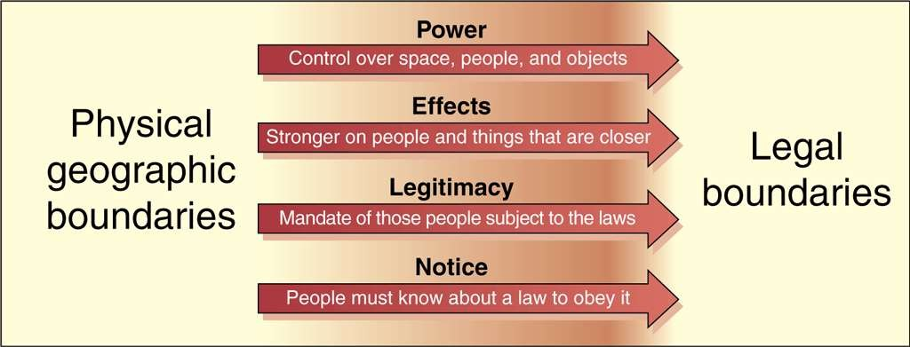
© Cengage Learning 2017
FIGURE 7-2 Physical geographic boundaries lead to legal boundaries
© 2017 Cengage Learning®. May not be scanned, copied or duplicated, or posted to a publicly accessible website, in whole or in part, except for use as permitted in a license distributed with a certain product or service or otherwise on a password-protected website or school-approved learning management system for classroom use.
7

Slide 8
Jurisdiction on the Internet
Difficult due to lack of geographic boundaries
Governments enforcing Internet business conduct
laws must establish jurisdiction over conduct
Contract is a promise between two or more entities providing for an exchange of value between them
Breach of contract occurs if either party does not comply with contract terms
Tort is an intentional negligent action taken by a legal entity that causes harm to another legal entity
Sufficient jurisdiction requires both subject-matter jurisdiction and personal jurisdiction
© 2017 Cengage Learning®. May not be scanned, copied or duplicated, or posted to a publicly accessible website, in whole or in part, except for use as permitted in a license distributed with a certain product or service or otherwise on a password-protected website or school-approved learning management system for classroom use.

Slide 9
Subject-Matter and Personal Jurisdiction
Subject-matter jurisdiction is a court’s authority to decide particular dispute type
Rules are clear and easy to apply (few disputes)
Personal jurisdiction is determined by residence of the parties
If defendant is a state resident where is court located the determination is straightforward
© 2017 Cengage Learning®. May not be scanned, copied or duplicated, or posted to a publicly accessible website, in whole or in part, except for use as permitted in a license distributed with a certain product or service or otherwise on a password-protected website or school-approved learning management system for classroom use.

Slide 10
Jurisdiction in International Commerce
Governed by treaties between countries in dispute
U.S. determines personal jurisdiction for foreigners in the same manner as domestic long-arm statutes
Non-U.S. entities can be sued in U.S. courts
– Foreign courts can enforce U.S. court system
decisions against U.S. corporations and individuals
Judicial comity is enforcing other countries’ laws out of a sense of comity (friendly civility)
Complex issue that is rapidly changing and should be considered when conducting business online
© 2017 Cengage Learning®. May not be scanned, copied or duplicated, or posted to a publicly accessible website, in whole or in part, except for use as permitted in a license distributed with a certain product or service or otherwise on a password-protected website or school-approved learning management system for classroom use.

Slide 11
Conflict of Laws
Business governed by various federal, state, and local laws
Conflict of laws occurs when laws address the same issues in different ways
Online businesses span many localities, states and usually look to federal laws for guidance
May lead to problems with state and local laws
Example: direct wine sales industry
More information: Free the Grapes wine industry
trade association Web site
© 2017 Cengage Learning®. May not be scanned, copied or duplicated, or posted to a publicly accessible website, in whole or in part, except for use as permitted in a license distributed with a certain product or service or otherwise on a password-protected website or school-approved learning management system for classroom use.

Slide 12
Contracting and Contract Enforcement in Electronic Commerce
Contract is formed when one party accepts the
Offer of another party
– Offer is a commitment with certain terms made to another party that can be revoked
Acceptance is the expression of willingness to take offer including all stated terms
Consideration is the agreed-upon exchange of something valuable such as money, property, or future services
Implied contract can be formed when parties act as if a contract exists, even if unwritten
© 2017 Cengage Learning®. May not be scanned, copied or duplicated, or posted to a publicly accessible website, in whole or in part, except for use as permitted in a license distributed with a certain product or service or otherwise on a password-protected website or school-approved learning management system for classroom use.

Slide 13
Creating Contracts: Offers and Acceptances
Every type of agreement or exchange between parties is a type of contract
Example: consumer buying item at a supermarket
Key element of traditional and Internet business
Internet communication offers and acceptances
Occur by exchanging e-mail, engaging in EDI, and filling out Web page forms
Can be combined with traditional methods
Courts tend to view offers and acceptances as actions that occur within a particular context
© 2017 Cengage Learning®. May not be scanned, copied or duplicated, or posted to a publicly accessible website, in whole or in part, except for use as permitted in a license distributed with a certain product or service or otherwise on a password-protected website or school-approved learning management system for classroom use.
18

Slide 14
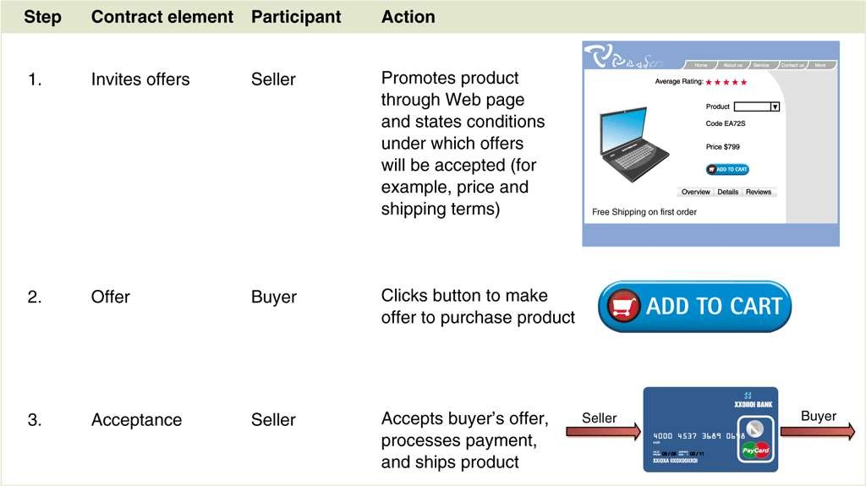
© Cengage Learning 2017
FIGURE 7-4 Contracting process in an online sale

Slide 15
Terms of Service Agreements
Many sites have stated rules visitors must follow even though the visitors are not aware of them
Terms of service (ToS) agreements are detailed rules and regulations
Limit Web site owner’s liability for what one might do with site information
Site visitor held to terms of service by simply using site

Slide 16
Creating Written Contracts on the Web
Many contracts valid even if not in writing or signed
Statute of Frauds (state laws) specify contracts that must be written and signed
Applies to sale of goods over $500 and contracts with actions that cannot be completed within one year
For electronic commerce a writing exists if contract terms reduced to some tangible form
Signature is any symbol executed or adopted for the purpose of authenticating a writing

Slide 17
Implied Warranties and Warranty Disclaimers on the Web
Implied warranty is a promise to which the seller can be held even though seller did not make an explicit statement of that promise
Law establishes basic elements of a transaction in any contract to sell goods or services
Warranty disclaimer is a statement declaring that the seller will not honor some or all implied warranties
Must be made conspicuously and in writing
Only legally effective if obvious and easy for a Web
site buyer to find

Slide 18
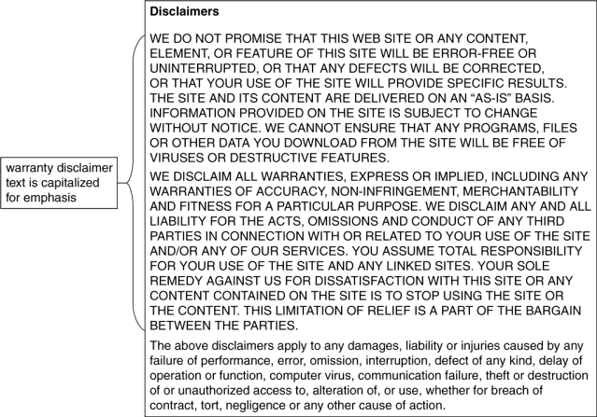
© Cengage Learning 2017
FIGURE 7-5 A Web site warranty disclaimer

Slide 19
Authority to Form Contracts
Contract formed when offer accepted for consideration
Problems with acceptance by an imposter (forgery) or someone without authority to bind company
Electronic commerce technology provides means to avoid deception such as use of digital signatures
Authority to bind issue arises when employee accepts a contract and company later asserts employee was not authorized
In physical world transactions check public information on file or copies corporate certificates or resolutions
Physical methods time consuming and awkward online

Slide 20
Defamation
Defamatory statement is false and injures reputation of another person or company
Product disparagement when statement injures product or service reputation
Web sites must consider specific laws before making
negative, evaluative statements about products
Designers must avoid potential defamation liability by not altering photos or images
Exceptions in U.S. for defamatory statements about public figures (not in other countries)
Per se defamation occurs when statements are so negative that injury is assumed

Slide 21
Deceptive Trade Practices
Manipulation of trademarked objects constitutes infringement of trademark holder’s rights
– Fictional characters can be trademarked
Web sites with links to other sites must not imply a relationship with companies sponsoring other sites unless it actually exists
Trademark protection prevents buyer confusion regarding trademark holder’s products or services
Trademark dilution is the reduction of distinctive trademark quality by alternative uses

Slide 22
Ethical Issues
Web sites conducting electronic commerce should adhere to same ethical standards other businesses follow
Failure to do so will result in damaged reputation, long-term loss of trust, and loss of business
Web advertising or promotion should include only true statements and omit misleading information
Product comparisons should be supported by verifiable information

Slide 23
Ethics and Online Business Practices
An ethical lapse reported and passed among customers can seriously affect company’s reputation
Examples: Amazon.com arrangements with publishers for book promotions, eBay firearm sales, Apple Apps store software approval time
Organizations face an ethical issues when collecting e-mail addresses from site visitors
In the U.S., no legal obligation to limit the use of information collected on Web sites
May use information for any purpose, including sale
Concern of individuals and privacy right advocates

